Slide 1


Slide 2


Today’s Agenda
Jquery Effects
Slide , Hide , Show and Fade
Applying Animation
Accessing HTML input controls

Slide 3
JQUERY EFFECTS
Effects in Jquery are animated behaviour shown by HTML elements.
The main jquery actions to be used for this are
Show
Hide
Fading
Animation

Slide 4
HIDE AND SHOW
As the name implies, hide( ) and show( ) are actions which can be used to make HTML elements either invisible or visible
The hide() method simply sets the inline style display: none for the selected elements.

Slide 5
HIDE AND SHOW
Conversely, the show() method restores the display properties of the element to whatever they initially were—typically block, inline, or inline-block—before the inline style display: none was applied to them.

Slide 6
SYNTAX
Syntax:
$(selector).show();
$(selector).hide();

Slide 7
EXAMPLE
<html>
<head>
<title>show() And hide() Demo</title>
<style type="text/css">
#div1 {
padding: 50px;
background-color: #89bc38;
text-align: center;
display: none;
}
</style>
<script src="../jquery.js"></script>
<script>
$(document).ready(function () {
$("#b1").click(function () {
$("#div1").show();
});
$("#b2").click(function () {
$("#div1").hide();
});
});
</script>
</head>

Slide 8
EXAMPLE
<body>
<input type="button" id="b1" value="show div" />
<input type="button" id="b2" value="hide div" /><br />
<div id="div1">
<b>Hello, world!</b>
</div>
</body>
</html>

Slide 9
HIDE AND SHOW
Both hide() and show() can take the two optional parameters: speed and callback.
Syntax:
$(selector).hide(speed,callback)
$(selector).show(speed,callback)

Slide 10
HIDE AND SHOW
The speed parameter specifies the speed of hiding/showing, and can take the following values:
"slow"
"fast“
"normal", or
milliseconds
The callback parameter specifies the function to be executed after the hide (or show) function completes

Slide 11
USING TOGGLE
The toggle() method in jQuery is used to toggle the visibility of HTML elements .
It simply shows an element if it is hidden or hides the element if it is visible .
Syntax:
$(selector).toggle(speed,callback);

Slide 12
EXERCISE
Modify the previous code so that when the div becomes visible , the alert box should display the message “div visible” and if the div gets hidden then it should display the message “div hidden”

Slide 13
APPLYING FADING
We can use the methods fadeIn() and fadeOut() for getting fading effect.
These methods display or hide the HTML element by gradually increasing or decreasing their opacity.

Slide 14
APPLYING FADING
The fadeIn() method gradually changes the opacity, of selected elements, from hidden to visible .
The fadeOut() method gradually changes the opacity, of selected elements, from visible to hidden .

Slide 15
APPLYING FADING
Syntax:
$(selector).fadeIn(speed,callback);
$(selector).fadeOut(speed,callback);

Slide 16
fadeIn/fadeOut V/s show/hide
The effect of fadeIn()/fadeOut() methods looks similar to show()/hide(), but there is an important difference.
Unlike show()/hide() methods the fadeIn()/fadeOut() methods only animate the opacity of the target elements and do not animate their dimensions.

Slide 17
USING fadeTo() METHOD
The fadeTo() method is similar to the fadeIn() method, but unlike fadeIn() the fadeTo() method lets us fade in the elements to a certain opacity level.
Syntax:
$(selector).fadeTo(speed,opacity,callback)
The opacity factor specifies the opacity to fade to and must be a number between 0.00 and 1.00

Slide 18
APPLYING SLIDING
We can use the methods slideDown() and slideUp() for getting sliding effect.
These methods display or hide the HTML element by gradually increasing or decreasing their height.

Slide 19
APPLYING SLIDING
The slideDown() method animates the height of the matched elements.
This causes lower parts of the page to slide down, making way for the revealed items.

Slide 20
APPLYING SLIDING
The slideUp() method animates the height of the matched elements.
This causes lower parts of the page to slide up, hiding away the revealed items.

Slide 21
APPLYING SLIDING
Syntax:
$(selector).slideUp(speed,callback);
$(selector).slideDown(speed,callback);

Slide 22
EXERCISE
Modify the previous code so that when the a is clicked the div should become visible and the text on a should change to Hide It .
Similarly when the div is visible and a is clicked the div should get hidden and the text of a should become See More… .

Slide 23
USING slideToggle()
The slideToggle() method causes toggle effect .
That means the elements which are up will slide down and vice versa .

Slide 24
APPLYING ANIMATIONS
The animate() method performs a custom animation of a set of CSS properties.
This method changes an element from one state to another with CSS styles.

Slide 25
APPLYING ANIMATIONS
The CSS property value is changed gradually, to create an animated effect.
But only numeric values can be animated (like "margin:30px").
String values cannot be animated (like "background-color:red").

Slide 26
APPLYING ANIMATIONS
Syntax:
$(selector).animate({styles},speed,callback);

Slide 27
HTML MANIPULATION
jQuery contains powerful methods (functions) for HTML elements and attributes.
These methods can not only access HTML controls but also manipulate their contents .

Slide 28
CHANGING HTML
The html() method changes the contents (innerHTML) of matching HTML elements.
Syntax
$(selector).html(content);
Example:
$("p").html("<b>Sachin</b>");

Slide 29
APPENDING HTML
The append() method appends the content to the inside of matching HTML elements.
Syntax:
$(selector).append(content);

Slide 30
ADDING HTML
The after() method adds the content after the matching HTML elements.
Syntax:
$(selector).after(content);

Slide 31
SETTING HTML ATTRIBUTE
The attr() method is used to set/change the attribute values.
Syntax:
$(selector).attr("attribute", "value");
Example:
$("button").click(function(){
$("a").attr("href", "https://www.scalive.in");
});

Slide 32
GETTING VALUE
The val() method sets/gets the input fields content
Syntax:
$(selector).val( );
$(selector).val(“some text”);

Slide 33
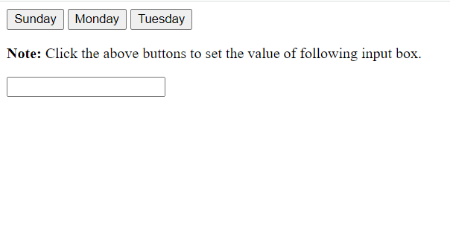
EXERCISE
Given below are 3 buttons and a text box.

Slide 34
EXERCISE
Write event handlers for each of the buttons so that on clicking that button its caption should be displayed in the text box

